Slide 1
Pipelined Processor
Gyaan Antia Cameron Brown Alexandra Day
CE 361 Fall 2021

Slide 2
Table of Contents
Usage Instructions
Traces
sort_corrected_branch.dat
unsigned_sum.dat
bills_branch.dat
Selected Schematics
Partial Routing Diagram
Partial Addressing Diagram
Design Decisions
Problems and Solutions

Slide 3
Traces - sort_corrected_branch.dat

Slide 4
Traces - unsigned_sum.dat

Slide 5
Traces - bills_branch.dat

Slide 6
Usage Instructions
To launch the simulation, from within the project directory, launch the following shell script:
#!/bin/sh
xrun -64bit -gui -access r test/p_processor_tb.v extralib/*/* src/* extralib/*.v
To change the test file, within src/p_processor.v, change the argument for parameter memory_file:

Slide 7
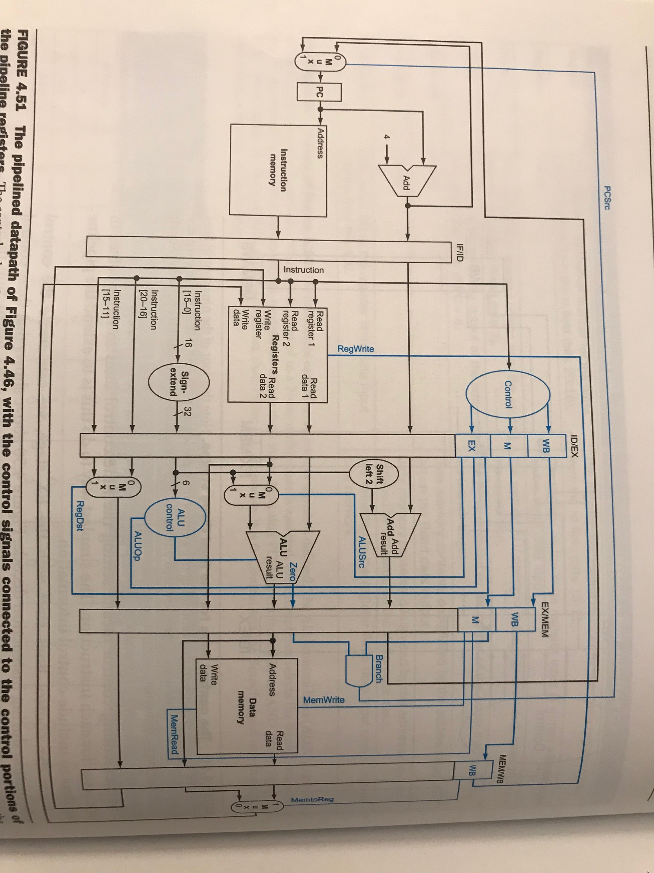
Partial Routing Diagram: shows all wires except for those supporting bne, bgtz
if_id_reg
id_ex_reg
ex_mem_reg
mem_wb_reg
Add_2_out
Ins_mem_out
Add_1_out
Add_2_out
Add_1_out
Add_1_out
Add_2_out
Read_data_1
Read_data_1
Data_mem_out
Notes: the diagram is from Computer Organization and Design, p. 304, by Patterson and Hennessy; wire names are case-insensitive relative to our circuit
Pc_out
Read_data_2
z
branch_mux_out
Alu_zero
Alu_result
Ins_mem_out
Alu_result
Mux_read_reg
Mux_write_reg
z
Ins_mem_out[n:m]
ext_out
Mux_write_reg
Mux_write_reg

Slide 8
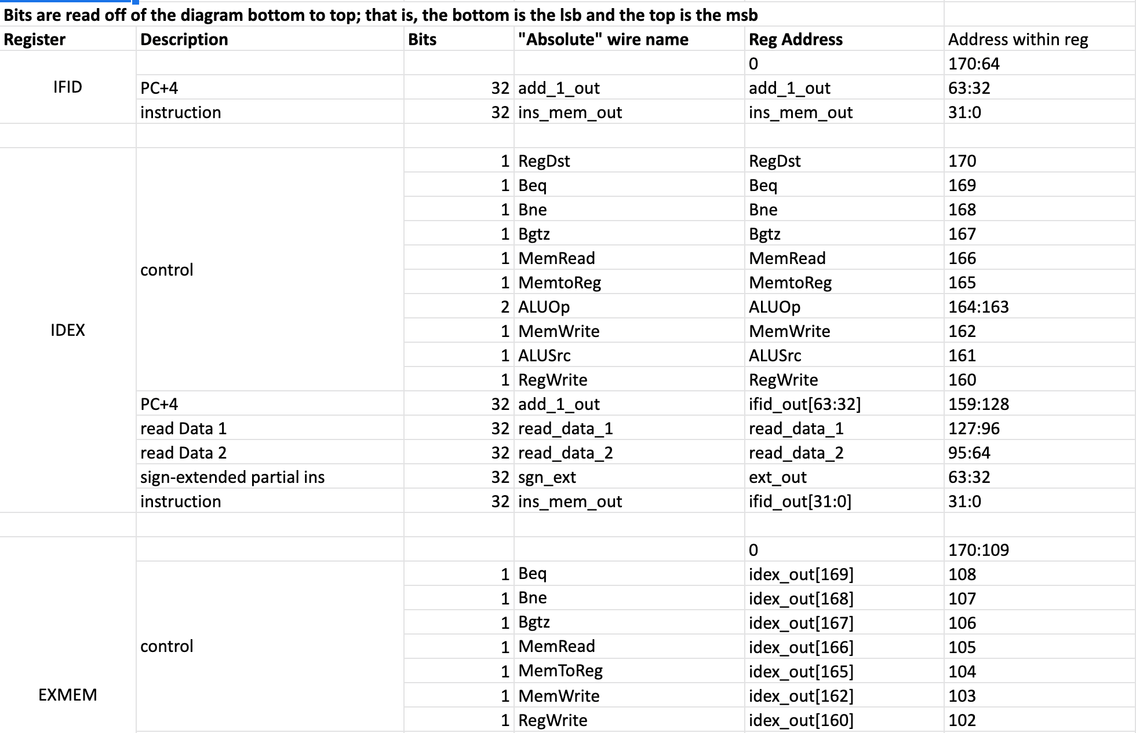
Partial Addressing Diagram
We kept track of our signals using a google doc, part of which is shown here.

Slide 9
Design Decisions (I)
We largely followed the book’s design for the pipelined processor on p. 304 and used hazard detection as shown on p. 316.
We used our single-cycle processor from the first group project, altered the wiring, added registers, and added control logic for the pipelining.
We made a few changes, including consolidating our branch logic from the single-cycle processor into a single module and making a few other modules, including 3-input muxes and larger registers.

Slide 10
Problems and Solutions (I)
Implementing the forwarding was a challenge.

